Slide 1
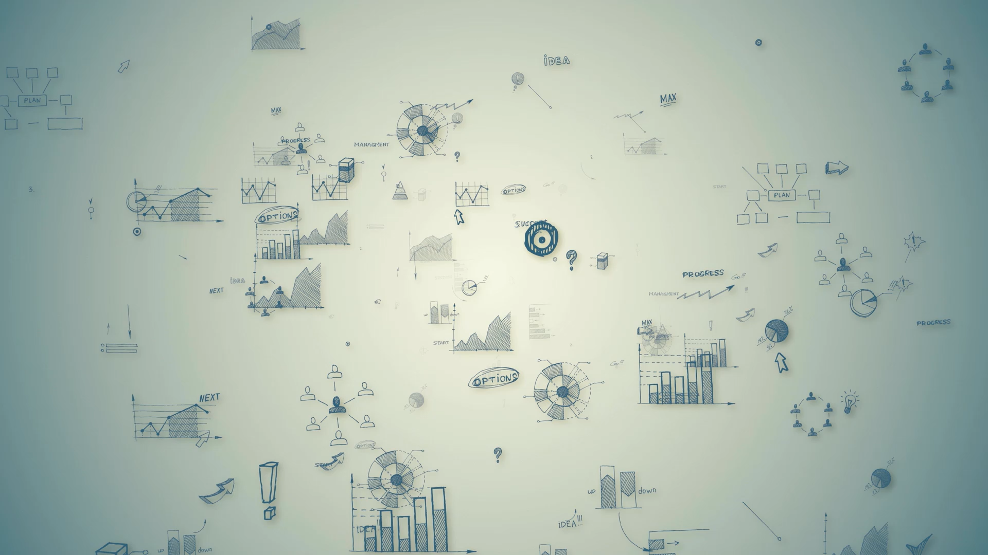
Title: Customer Insights and Brand Strategy Report for xxx Limited
Objectives: Understand brand sentiment, customer behavior, and response effectiveness

Slide 2
Customer and Sales Insights Dashboard Aim : To Analyze revenue, customer demographics, and product sales.
Revenue Analysis
Laptops were the highest selling products, while 2022 was the best year for sales.
Sales generally improve from April until July, July being the peak sale period, before it generally declines then steadily climbs up from October. February has the poorest sale period.
Customers Ages 46-60 form the largest customer base. Nebraska, West Virgina Montana have the highest concentration of the customer base, there is opportunity to expand and do more market penetration into other regions.
Returning customers purchase more products , therefore the brand is doing well in customer retention and the products are acceptable in the market. The returning and vip customers are the top spenders, high value customers which must be protected. They also have the largest complaints, therefore efforts should be made to resolve their issues quickly so as to retain their patronage.

Slide 3
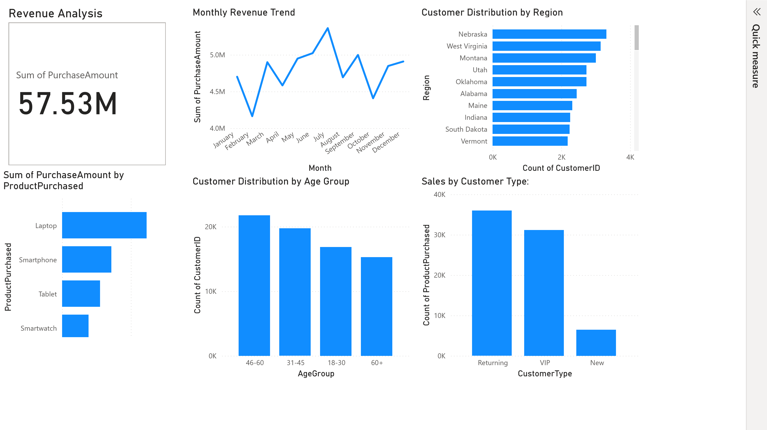

Slide 4
Brand Sentiment and Social Media Dashboard Aim : Track sentiment trends, analyze social media engagement, sentiment distribution and complaint patterns, competitor mentions
Brand Sentiment & Social Media Analysis
Arkansas, Kansas, Maine, had predominantly positive sentiment trends with high increase in 2023, however Ohio had a sharp drop from 2022 to 2023.
Positive feedback was more across the sentiment distribution, however there is also high neutral sentiment, therefore it is recommended that efforts should be made to convert the neutral feedback into positive ones.
Instagram has the highest engagement shares, Tiktok the highest likes , while Twitter has the highest comments. Of the social media platforms, Tiktok has the largest engagement.
Top Mentioned Competitors are MarsTech with 19517 mentions, MetaTech with 18309 mentions and SmartTech with 17949 mentions.
Most complaints (negative sentiments) originate from Instagram , 2882, followed by LinkedIn, 2870, Tiktok, 2683, Facebook, 2483 with the least from Twitter , 2465 complaints. . Given the above analysis, it is recommended that Twitter should be used as the main social media platform to drive engagement and obtain positive feedback.
There are more mentions of the brand, 37773, than the competitor's ,36870, however there can be further gap by increasing the reach of the brand through increased mentions and impact.
Stories, videos and images in that order are the best post types for increased influencer impact.
From October 2022, the influencer impact gradually increases, remained relatively constant throughout the first quarter of 2023 but steadily declined between April 2023 to October 2023.
Customer ids 126 ,17 and 116 are the top influencers as they have the largest average engagement in relation to their user followers and influencer score.

Slide 5
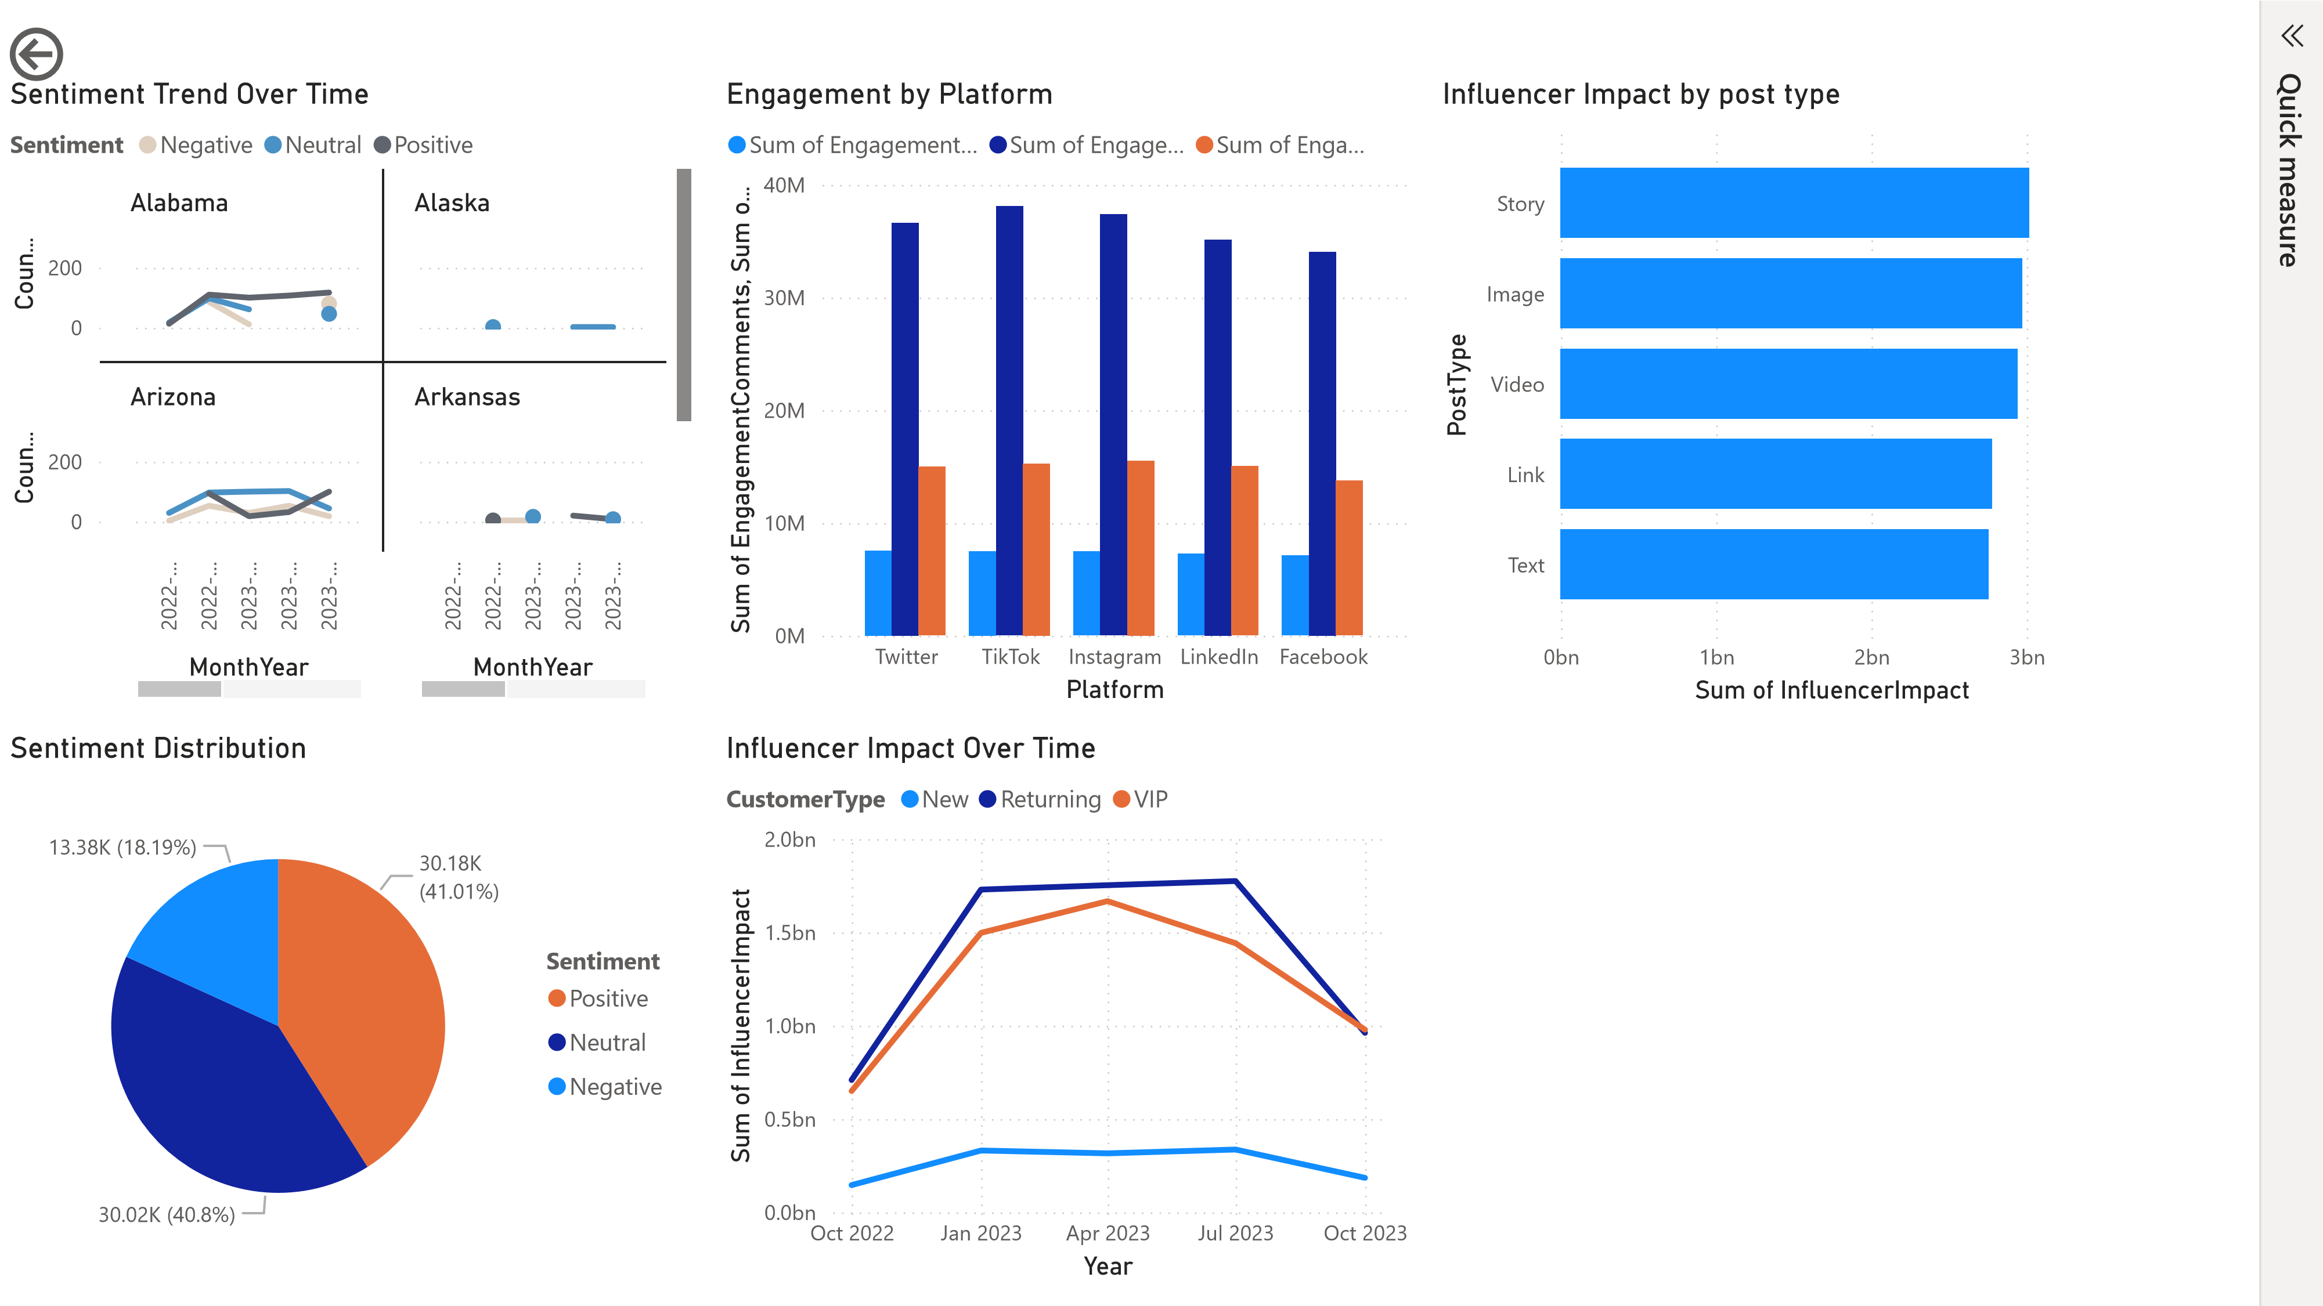

Slide 6
Customer Complaints and Crisis Management Dashboard Aim: Monitor product recalls, crisis, response, and complaint trends.
Customer Complaints & Crisis Management Analysis
July 2022, had the highest product recalls 2209 and most complaints occur in this month.
March and December are favorite moths of the year when positive feedbacks are received.
Most customer complaints emanated from West Virginia, Nebraska and Montana , majority were from Vips and retuning customers. It is deduced that new customers had fewer complaints.
The average response time is 189 days, 23 hours, 18 minutes which is ineffective and poor turnaround time. The highest response time is 9 months and 8days while the shortest time is 1 day.
The platforms with the fastest NPS response are Linkedin, Instagram and TikTok.
Most complaints still remained unresolved after a long resolution time.

Slide 7

Recommendations
Improve
Improve crisis response time, engage high-performing influencers, and address common complaints.
Focus on
Focus on high performing products like laptops.
Improve on
Improve on deep penetration market strategy for underperforming region.
Increase
Increase sales in March and December to maximize profits.

